Slide 1

Clip Scholar: Leveraging LLMs for AI-Driven Educational Content Generation
github repository link : https://github.com/madhans476/Clip-Scholar
Presentation Video link: https://drive.google.com/file/d/1ugpF9SnrGpvORU93oDEbQpyETSc7GHF1/view?usp=drive_link

Slide 2
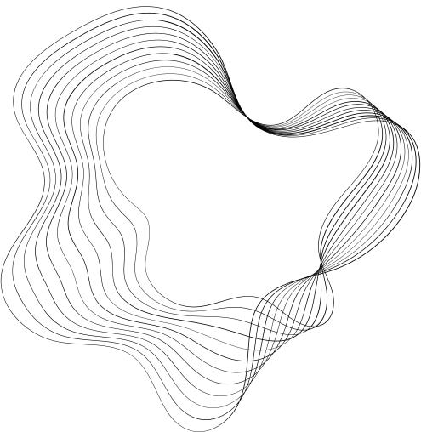
GROUP MEMBERS
Bharath L (22bds013)
Gnanesh A R (22bds023)
Gopal (22bds025)
Madhan S (22bds036)
Nachiket Apte (22bds041)

Slide 3
CONTENTS
Introduction
System Architecture
Architecture of Mistral LLM
Data Flow for Notes Generation
Data Flow for Flashcards Generation
Data Flow for Quiz Generation
Integration with AWS

Slide 4
Introduction
In today’s fast-paced world, watching full-length educational videos can be time-consuming and inefficient. Leveraging AI to extract insights from YouTube videos offers a smarter, faster, and more personalized learning experience. It:
Saves Time: AI summarizes long videos into key takeaways.
Improves Clarity: Dense or complex information is broken down into simple, structured formats using advanced language models.
Quick Searchability: AI-generated transcripts allow users to instantly find specific terms or topics within a video.
Enhances Accessibility: Supports different learning needs by offering readable content and tools for learners who prefer text over video.
Reference : M. N. Giannakos, K. Chorianopoulos, and N. Chrisochoides, “Making sense of video-based learning analytics: Lessons learned from youtube,” IEEE Transactions on Learning Technologies, vol. 8, no. 4, pp. 356–369, 2015.

Slide 5
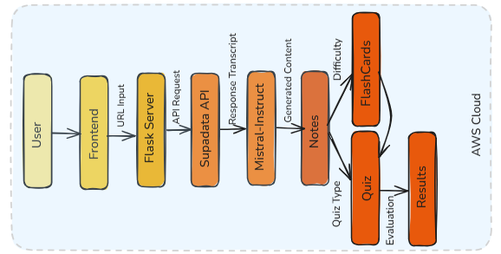
System Architecture
References:
M. Grinberg, Flask Web Development: Developing Web Applications with Python. O’Reilly Media, 2nd ed., 2018.
H. Hosseini, T. Doran, and S. Kim, “Building scalable web apis with flask and python,” IEEE Computing in Science Engineering, vol. 23, no. 2, pp. 46–55, 2021.

Slide 6
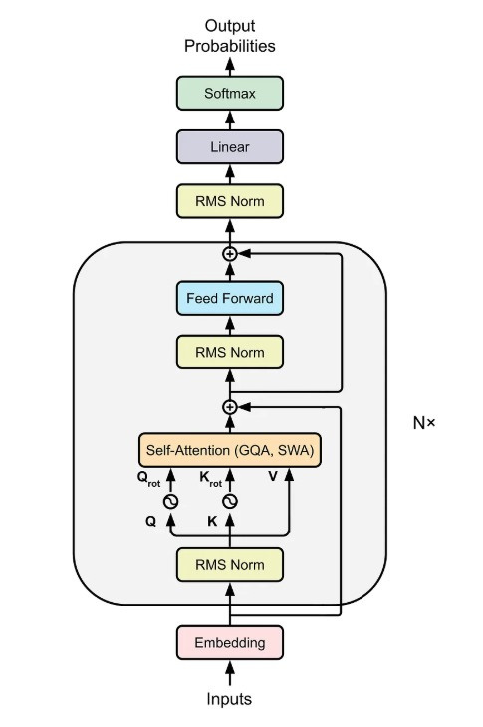
Architecture of Mistral-Large-Instruct
Embedding Layer: Converts input tokens into dense vector representations.
RMS Norm: Root Mean Square Layer Normalization is applied before attention and feed-forward blocks.
Self-Attention Block:
Uses GQA (Grouped Query Attention) and SWA (Sliding Window Attention) for efficient and localized attention.
Rotational embeddings (Q_rot, K_rot) are applied for positional encoding.

Slide 7
Architecture Contd.
Feed Forward Block: A position-wise dense layer applied after attention with residual connections.
Repeated N times: The attention + feed-forward block is stacked multiple times.
Final RMS Norm: Applied after all transformer layers.
Linear + Softmax: Final layers to produce output probabilities over vocabulary.
References
Mistral AI, “Mistral-large-instruct-2411 model,” 2024. [Online]. Available: https://mistral.ai/.
A. Q. Jiang, A. Sablayrolles, A. Mensch, C. Bamford, D. S. Chaplot, D. de las Casas, F. Bressand, G. Lengyel, G. Lample, L. Saulnier, L. R. Lavaud, M.-A. Lachaux, P. Stock, T. Le Scao, T. Lavril, T. Wang, T. Lacroix, and W. El Sayed, “Mistral 7b,” arXiv preprint arXiv:2310.06825, 2023.

Slide 8
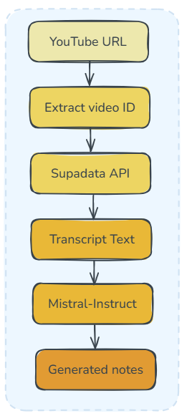
Data Flow for Notes Generation
The application first requests the user to enter the YouTube URL
The id of the video is extracted using regex and sent to the Supadata API
Supadata is a comprehensive API service that extracts the transcripts of a video using the captions present in it.
The transcript text is then sent as a prompt to the Large Language Model Mistral-Large-Instruct using API to process and generate notes.
Reference: Supadata ai transcript extractor.” [Online]. Available: https://supadata.ai/.

Slide 9
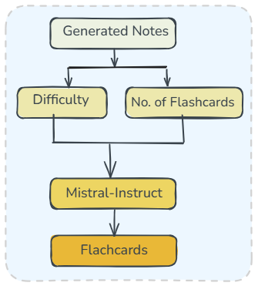
Data Flow for Flashcards Generation
Following the notes generated, we give the user the option to generate flashcards.
To do so, the difficulty of the content is selected along with no of flashcards
These are fed along with the notes generated as a prompt to the LLM.
The output json is rendered and flashcards are produced.

Slide 10
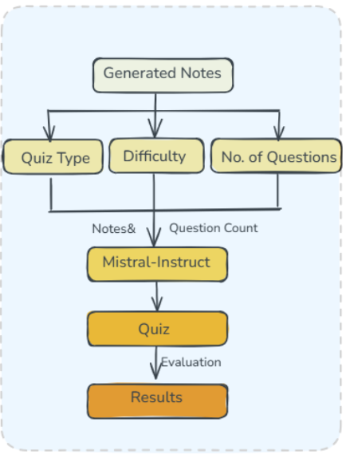
Data Flow Diagram for Quiz Generation
For quiz generation, the difficulty level is selected, along with quiz type viz MCQ, Fill in the blanks and Short Answer Questions.
The notes are the then fed along with this to the Mistral Model as a prompt using the API key.
The results in JSON format are parsed and shown to the user using JavaScript.
The answers are then evaluated using the pre-available answers (question and answers are generated together) and the result shown.

Slide 11
Hosting on AWS
The website is hosted on Amazon AWS EC2.
EC2 are basically virtual servers for running applications.
The website is run using gunicorn and exposed on the default http port 80.
gunicorn is a Python HTTP server for running Python web applications built with frameworks like Flask, Django, etc.
Reference - Amazon Web Services, Amazon EC2 Documentation, 2024. [Online].
Available: https://docs.aws.amazon.com/ec2/.

Slide 12
Thank You

